Slide 1
Front-End Frameworks
Vijay Velagapudi

Slide 2




Map
Getting Started
Front End
Back End
Advanced Topics
Introduction
Fundamentals
Git
Command Line
HTML
CSS
Responsive Design
JavaScript & jQuery
Web Frameworks
Architecture
Database Design
APIs
Visualization
Security
Deployment
Notes:
This is the course map for IOLab 2016
We have packaged the course in four modules

Slide 3
Map
Getting Started
Front End
Back End
Advanced Topics
Introduction
Fundamentals
Git
Command Line
HTML
CSS
Responsive Design
JavaScript & jQuery
Web Frameworks
Architecture
Database Design
APIs
Visualization
Security
Deployment
Notes:
This is the course map for IOLab 2016
We have packaged the course in four modules

Slide 4
You will Learn About
Spaghetti Code
Javascript Framework Landscape
Backbone
React
Angular
Ember
When to use frameworks
Notes:
Programmers have found that developing for the web in the modern day with rudimentary tools is difficult.
Various solutions have been created to try to address this problem
Our goal is to look at the problems that we are solving and choose the right tools to do so

Slide 5
The Problem

Slide 6
Spaghetti Code
“Spaghetti code is a pejorative phrase for source code that has a complex and tangled control structure, especially one using many GOTO statements, exceptions, threads, or other "unstructured" branching constructs. It is named such because program flow is conceptually like a bowl of spaghetti, i.e. twisted and tangled… Structured programming greatly decreases the incidence of spaghetti code.” – Wikipedia

Slide 7
Cat Clicker - Revisited
Visuals
The application should display
a list of cats by name
an area to display the selected cat
In the cat display area, the following should be displayed
the cat's name
a picture of the cat
text showing the number of clicks
Interaction
When a cat name is clicked in the list, the cat display area should update to show the data for the selected cat.
The number of clicks in the cat area should be unique to each cat, and should increment when the cat's picture is clicked.

Slide 8
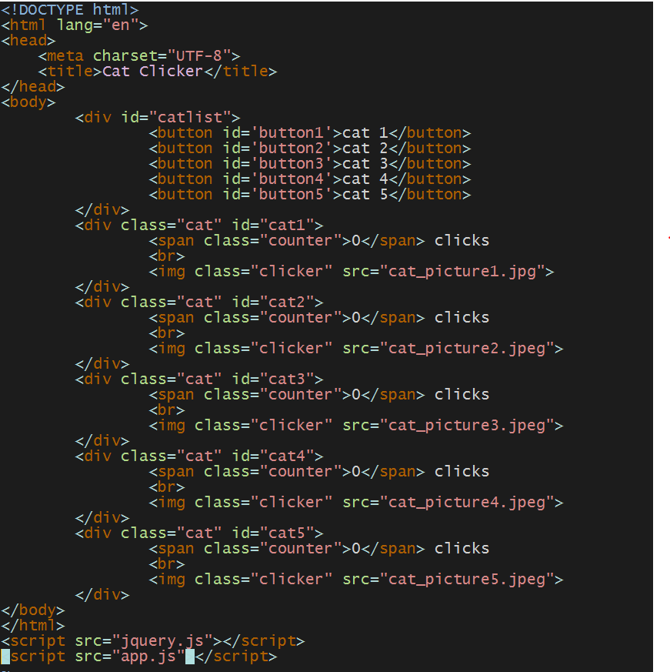

Slide 9
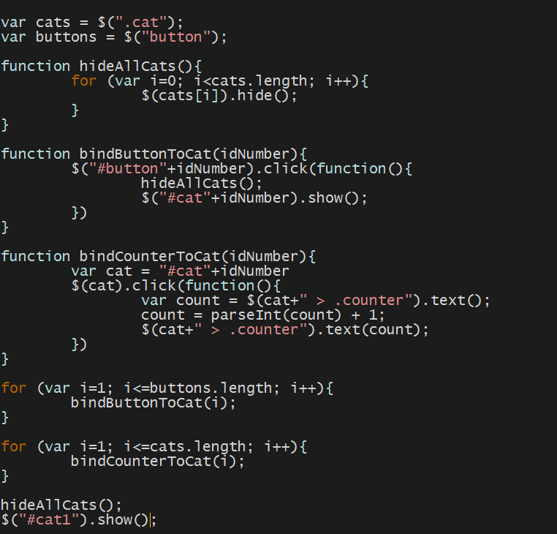
Notes:
Ask the class

Slide 10
Notes:
This is not desired for several reasons…
While this may be okay for even 5 cats, it doesn’t extend well to more cats…
It’s also very ugly to look at and difficult to debug

Slide 11
Design Principles
Self Contained Modules
Everything to do with a module is in that module
No Global Variables
If a module manages more than one thing it should be split up
Separation of Concerns
DRY: Don’t Repeat Yourself!
Notes:
When we are writing javascript, we should aim to follow these principles as closely as possible
Taken from https://www.youtube.com/watch?v=HkFlM73G-hk&list=PLoYCgNOIyGABs-wDaaxChu82q_xQgUb4f

Slide 12
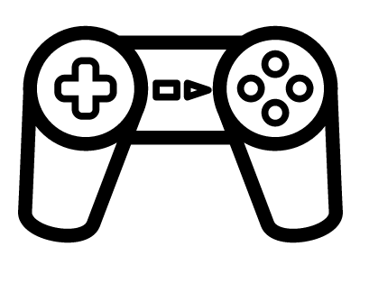
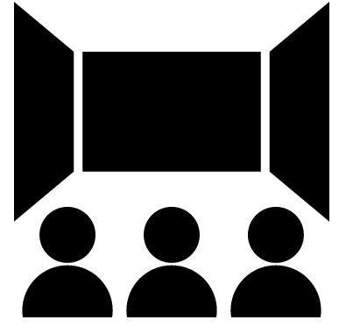
MVC Pattern
Model
View
Controller
Notes:
The model represents the data, and does nothing else. The model does NOT depend on the controller or the view.
The view displays the model data, and sends user actions (e.g. button clicks) to the controller. The view can:
be independent of both the model and the controller; or
actually be the controller, and therefore depend on the model.
The controller provides model data to the view, and interprets user actions such as button clicks. The controller depends on the view and the model. In some cases, the controller and the view are the same object
http://www.tomdalling.com/blog/software-design/model-view-controller-explained/

Slide 13
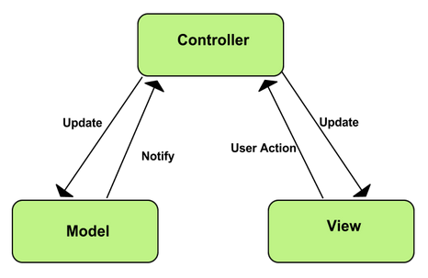
MVC

Slide 14
MVC Pattern
Separation of concerns!
Application Logic
Application presentation
Information persistence
The other stuff:
Routing, templating, sessions , HTTP, Networking.. etc
Notes:
https://lostechies.com/derekgreer/2007/08/25/interactive-application-architecture/

Slide 15
Frameworks To the Rescue… sort of
MVC framework on the client side
Forces you to follow certain design patterns
Clear separation of concerns
Greater testability
Learn new library
Notes:
Frameworks force code to be written in a very particular way, usually following some set of design principles.
Help you avoid writing spaghetti code
And, depending on which framework you are using, they do much more
They are entirely client-side - generally they communicate with a server via JSON over HTTP, so they are somewhat agnostic of the language you use on the server. You aren't likely to use PHP as it's client-focused, but I've seen these frameworks used with backends in Sinatra, Ruby on Rails, Node.js, Scalatra (Scala) and Compojure (Clojure) - one of the nice features of them is they let you choose the best language for the job, server-side.
The general theory is they provide some kind of Model/View/Controller logic in the browser (or MVVM, but that's a longer tale). You have Models that reflect some subset of the server-side model of your application, Views that handle displaying a representation of the Modls on the DOM, and Controllers that handle user activity and coordinate changes to the Model and View, and synchronisation of data back to the server.
Generally these client-side applications assume you work within a single page in the browser. You can have apparent page transitions within that page, but actually the app is just manipulating the current DOM to have new content, rather than a traditional new URL in a browser, where the entire state is thrown away and a new page is loaded. (You can have different pages for significant different parts of your app, but it's rare)
Benefits of this approach are:
Clean separation of concerns - all your view logic is in the browser, and most of your business logic is in the server. This makes it easier to develop these two parts somewhat separately, and you can have multiple front-ends using the same back-end - say for mobile apps, or for communicating between your server and other systems
Greater testability - you can test your app entirely in a browser, using a framework like jasmine and stubbing out the server-side JSON interactions. You can also test the server on it's own, simulating the JSON interactions from the client.
Easier logic for complex web apps - if you want a lot of dynamic state in a web app, the MVC structure gives you a great way to structure a complex JavaScript app.
The downsides are:
Performance can be poorer than server-side generated sites, especially when those sites are mostly static, or very large. You are offloading a lot of your rendering logic to the browser, which is OK most of the time, but can be a problem with old browsers, or overly complex pages. Also, if your server can't handle the load, slow asynchronous responses can make your UI unusable, whereas html sites degrade rather more gracefully.
Nothing will work without JavaScript turned on. No progressive enhancement, nothing. There has been debate about how many people this affects, figures are 1% of users (from Yahoo in 2010) and 1.5% of people with disabilities using screen readers (WebAIM 2012) - for some people this is still a big deal.
Search Engine Optimisation can be a real problem - basically the big search engines usually don't render JavaScript, so if you want your page to be indexed by Google, you have to jump through extra hoops to render a static version of the site.
These things are still rather new, and require a chunk of learning, whereas more traditional frameworks like Ruby on Rails or PhP are well established and may be easier for those already familiar with them.
If you want a good overview of lots of these frameworks, take a look at http://todomvc.com/
- it's the same app, rendered in lots of different frameworks.
TL;DR: Great for complex interactive web applications, less great for mostly static web sites or places with twitter-like performance needs.
disclaimer: I've been building stuff this way for several years, and I'm a sad neoholic, so am probably rather biased

Slide 16
Framework Landscape
Libraries
Address specific problem area(s), minimalist
Examples: React, Backbone, JQuery
Frameworks
Full-featured MVCs
Examples: AngularJS, EmberJS, etc.
Platforms
Prescriptive, include server side code
Examples: Meteor
Notes:
Solutions usually take several different forms
Libraries, Full featured frameworks, or platforms
There is a lot of overlap between their features
We will explore some of these frameworks to understand the types of problems that they are trying to solve
This is not an exhaustive list, there are many more javascript frameworks and libraries
But, these are some of the most popular

Slide 17
The Classic

Slide 18
Backbone.js
One of the oldest Javascript Frameworks
Minimalist MVC
Used at Twitter, Hulu, Pinterest, and Pandora

Slide 19
The Good Stuff
Compact
Flexible
Works well for apps where speed is a priority

Slide 20
Concerns
Minimalism
No server-side rendering*
* We’ll talk about this later in the semester

Slide 21
The Popular One

Slide 22
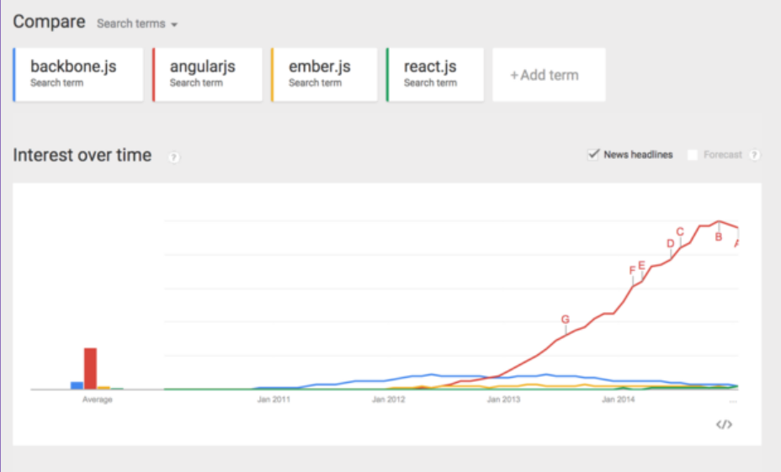
Angular
Notes:
Shows the relative popularity of them all

Slide 23
Angular
Much more full featured
Templating, Two-way data binding, Directives, etc.
Used at VEVO, The Weather Channel, and MSNBC
Notes:
Two way db: In Angular, both the Model and the View can update the data, thus the “two-way” descriptor.
Have to write less code
Directives: Extend HTML by attaching special behaviors to parts of the dom.
You can for example, repeat an HTML element n number of times without having to manually write it out

Slide 24
The Good Stuff
Lots of people are using it
Sponsored by Google
Fairly Stable

Slide 25
The Bad Stuff
Can be slow
In large complex apps
Angular 2 will be released
No backwards compatibility

Slide 26
The New Kid

Slide 27
React
React is more of the V part of the MVC
Allows it to be used with many different libraries and frameworks
Used at Facebook, Instagram, Flipboard, BBC, and Netflix

Slide 28
The Good Stuff
Very fast
Uses a virtual DOM
Easy to learn
Very little domain specific language
Can easily create native apps with React Native

Slide 29
The Bad Stuff
No templates
Have to use components to generate the UI
Debugging can be difficult at times

Slide 30
Picking One

Slide 31
When Would I Use What?
Evaluate you needs first
Are you building a large or small project?
Who will be responsible for maintaining the code?
Is speed more important than accuracy? Reliability?
Compare your needs to what popular websites are using.
If your needs are similar? Can you use their framework(s)?
If not, which things are different? Which part of the stack needs to change?

